Slide 1

Elementary PE Unit
Baseball/Softball
Daily Activity Plans

Slide 2
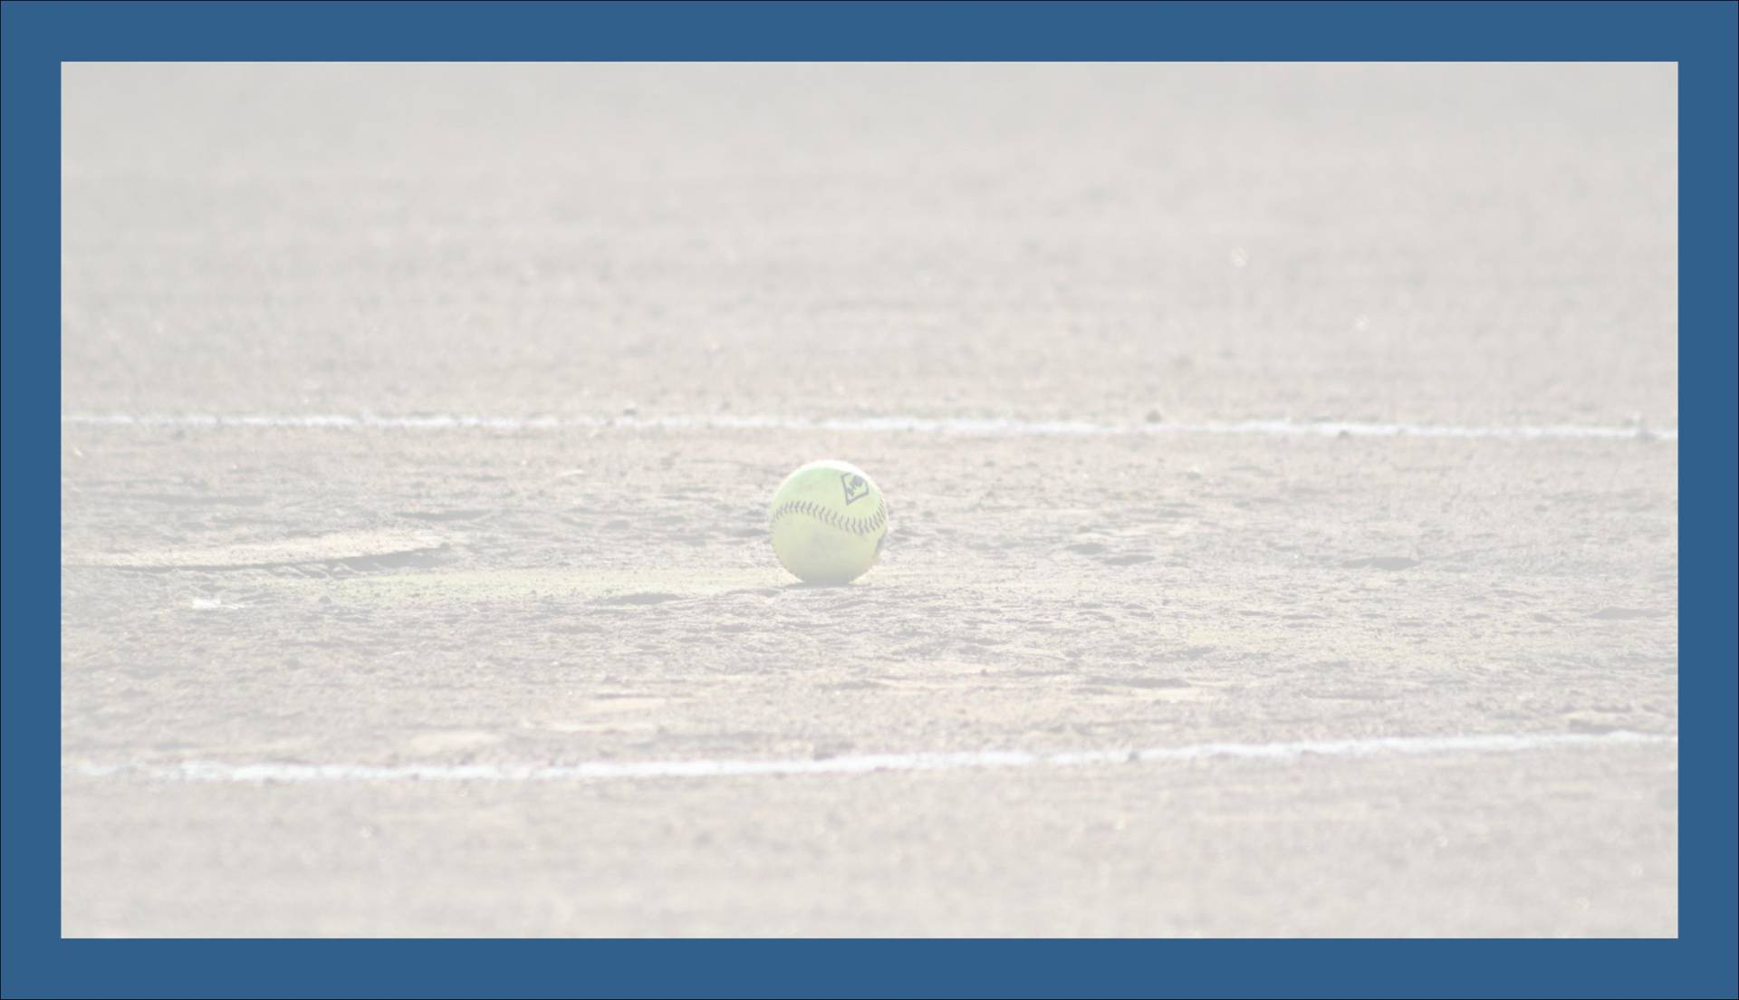
Baseball/Softball Unit - Day 1
Daily Warm-Up: Dynamic Warm-Up
Review: Always Be a Good Sport!
Daily Skill: Introduction to Baseball/Softball
Game: Wall Target Toss
What Am I Learning Today? How to Be a Good Sport Basics of Baseball and Softball
Standards Covered S1.E1 - Combines traveling with manipulative skills for the execution of a skill (running and throwing, kicking and running) S1.E2 - Runs for a distance using a mature pattern S1.E14 - Throws overhand to a partner or at a target with accuracy at a reasonable distance.

Slide 3
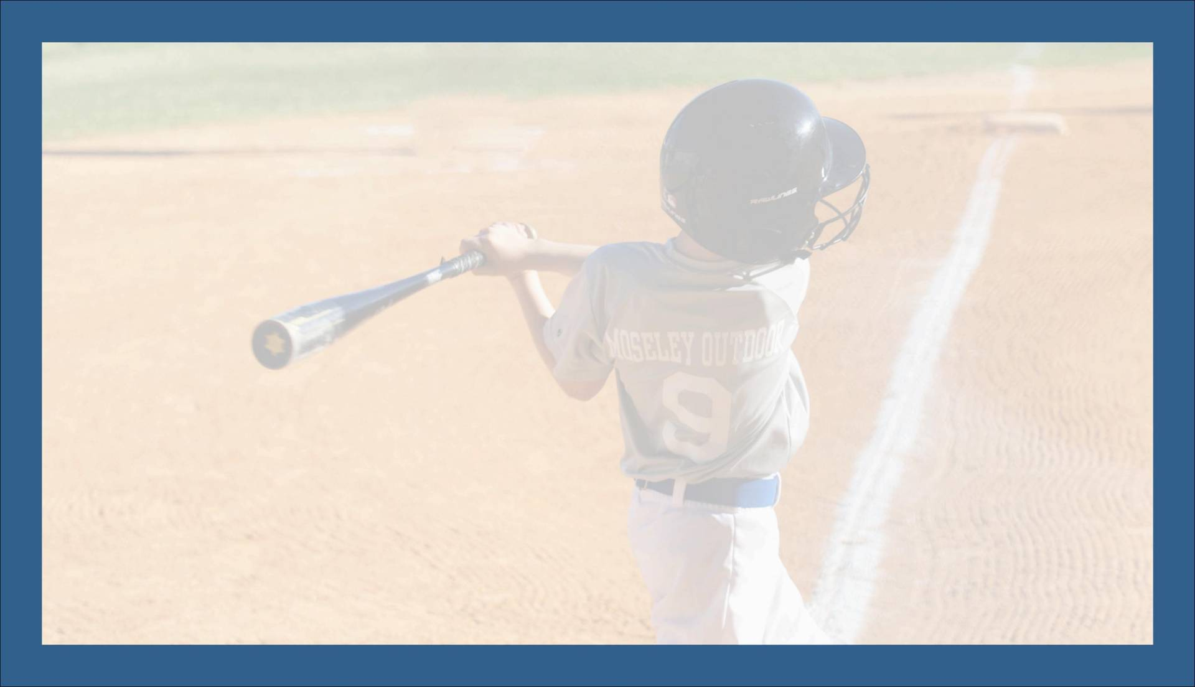
Baseball/Softball Unit - Day 2
What Am I Learning Today? How to Throw a Ball Throwing to Teammates
Standards Covered S1.E1 - Combines traveling with manipulative skills for the execution of a skill (running and throwing, kicking and running) S1.E2 - Runs for a distance using a mature pattern S1.E14 - Throws overhand to a partner or at a target with accuracy at a reasonable distance.
Daily Warm-Up: Partner Toss
Review: Tic-Tac-Toe Wall Toss
Daily Skill: Throwing Basics
Game: Bucket Ball

Slide 4
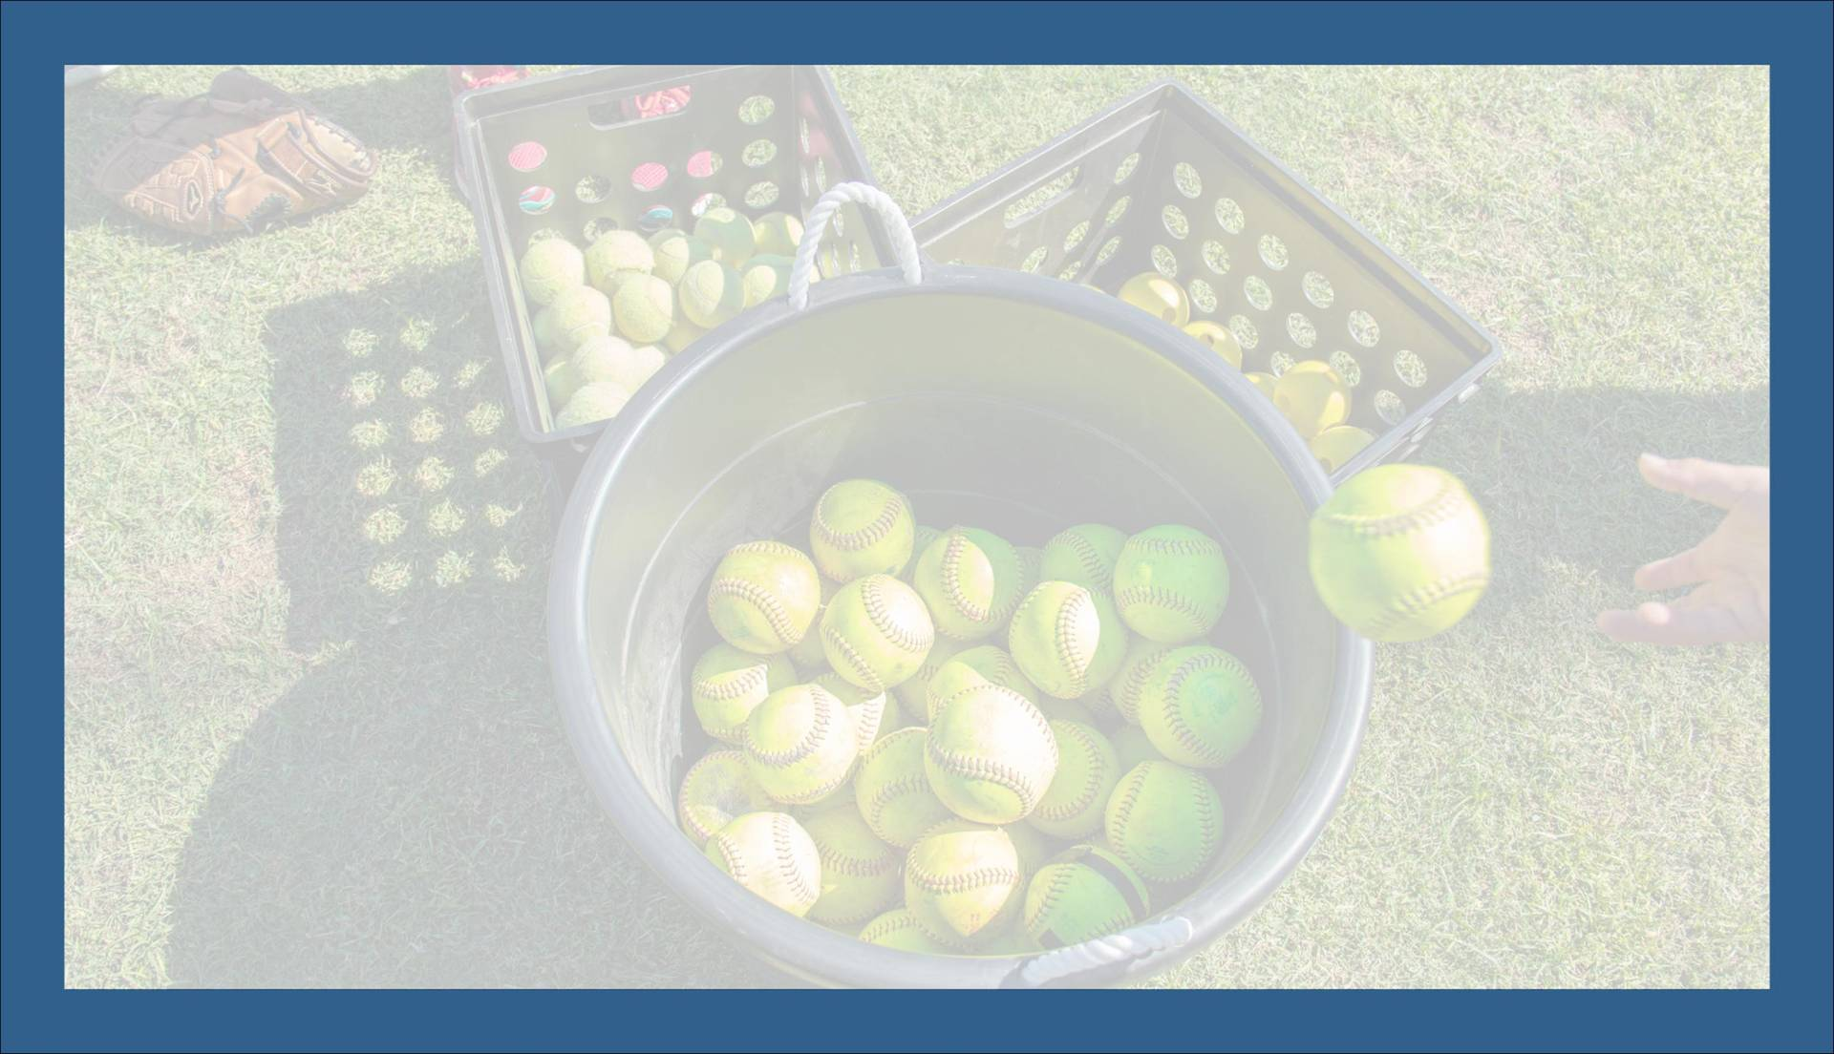
Baseball/Softball Unit - Day 3
What Am I Learning Today? How to Throw a Ball Throwing to Teammates
Standards Covered S1.E1 - Combines traveling with manipulative skills for the execution of a skill (running and throwing, kicking and running) S1.E2 - Runs for a distance using a mature pattern S1.E14 - Throws overhand to a partner or at a target with accuracy at a reasonable distance. S1.E16 - Catches a batted ball above the head, at chest or waist level, and along the ground using a mature pattern
Daily Warm-Up: Base Runner Relay
Review: Improving Your Throwing Skill
Daily Skill: Throwing for the Ball Further
Game: Sink the Ship

Slide 5

Baseball/Softball Unit - Day 4
What Am I Learning Today? How to Throw a Ball How to Catch a Ball
Standards Covered S1.E1 - Combines traveling with manipulative skills for the execution of a skill (running and throwing, kicking and running) S1.E2 - Runs for a distance using a mature pattern S1.E14 - Throws overhand to a partner or at a target with accuracy at a reasonable distance. S1.E16 - Catches a batted ball above the head, at chest or waist level, and along the ground using a mature pattern
Daily Warm-Up: Dynamic Warm-Up
Review: Step Back Catch
Daily Skill: Basics of Catching a Ball
Game: Knock Over Ball

Slide 6

Baseball/Softball Unit - Day 5
What Am I Learning Today? How to Catch a Ball How to Use a Baseball and Softball Glove
Standards Covered S1.E1 - Combines traveling with manipulative skills for the execution of a skill (running and throwing, kicking and running) S1.E2 - Runs for a distance using a mature pattern S1.E14 - Throws overhand to a partner or at a target with accuracy at a reasonable distance. S1.E16 - Catches a batted ball above the head, at chest or waist level, and along the ground using a mature pattern S4.E2 - Participates with responsible personal behavior in a variety of physical activity contexts, environments, and facilities
Daily Warm-Up: Ground Ball Game
Review: Infield Relay
Daily Skill: Catching with a Glove
Game: Beach Ball Baseball

Slide 7
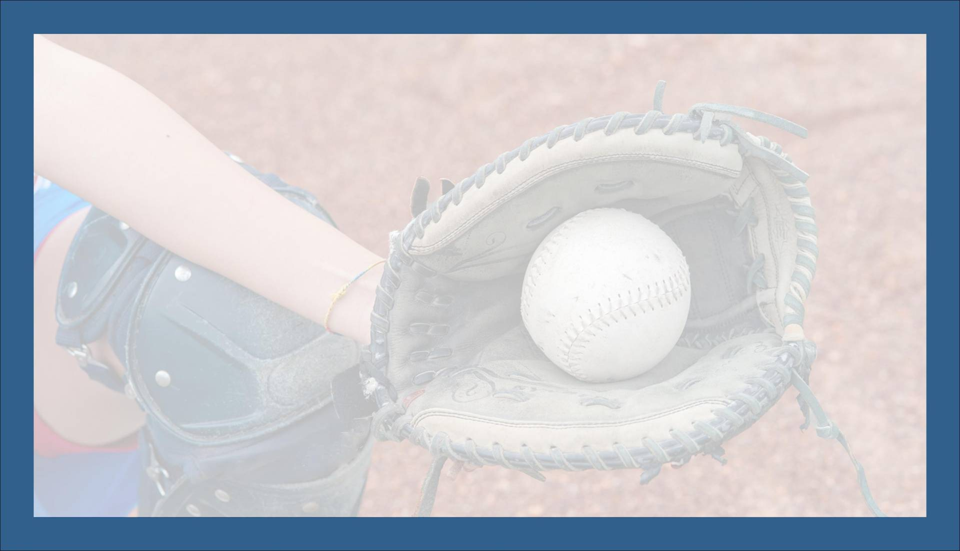
Baseball/Softball Unit - Day 6
What Am I Learning Today? How to Swing a Bat How to Hit a Baseball or a Softball
Standards Covered S1.E1 - Combines traveling with manipulative skills for the execution of a skill (running and throwing, kicking and running) S1.E2 - Runs for a distance using a mature pattern S1.E14 - Throws overhand to a partner or at a target with accuracy at a reasonable distance. S3.E2 - Engages actively in all activities of physical education S4.E2 - Participates with responsible personal behavior in a variety of physical activity contexts, environments, and facilities
Daily Warm-Up: Partner Long Toss
Review: Catching Fly Balls
Daily Skill: Batting Stance and Swinging the Bat
Game: Defense Scores Softball

Slide 8
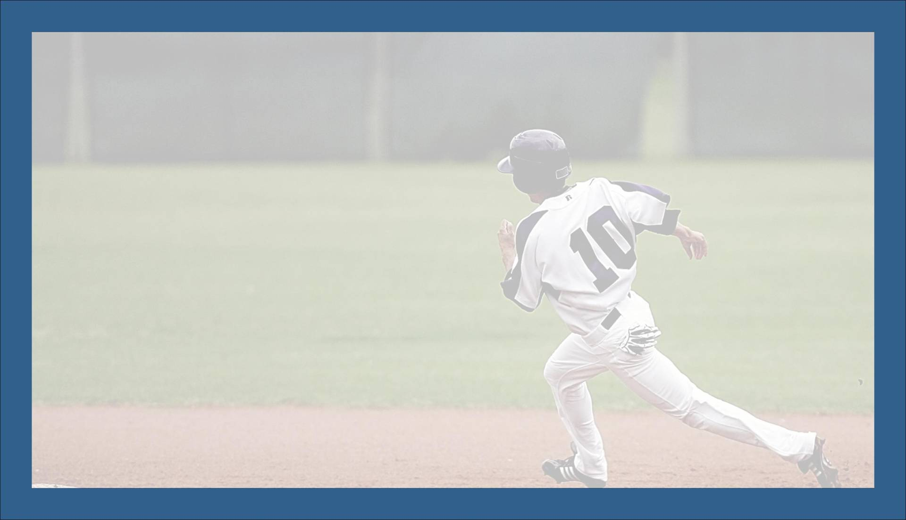
Baseball/Softball Unit - Day 7
Daily Warm-Up: Dynamic Warm-Up
Review: Foam Ball Batting Cage
Daily Skill: Hitting a Softball
Game: Soft Toss Baseball or 3 Inning Softball
What Am I Learning Today? How to Swing a Bat How to Hit a Baseball or a Softball
Standards Covered S1.E1 - Combines traveling with manipulative skills for the execution of a skill (running and throwing, kicking and running) S1.E2 - Runs for a distance using a mature pattern S1.E14 - Throws overhand to a partner or at a target with accuracy at a reasonable distance. S3.E2 - Engages actively in all activities of physical education S4.E2 - Participates with responsible personal behavior in a variety of physical activity contexts, environments, and facilities

Slide 9

Baseball/Softball Unit - Day 8
Daily Warm-Up: High Partner Toss
Review: Home Run Derby
Daily Skill: Running Bases
Game: Baseless Softball
What Am I Learning Today? How to Play Various Baseball and Softball Games How to Run the Bases
Standards Covered S1.E1 - Combines traveling with manipulative skills for the execution of a skill (running and throwing, kicking and running) S1.E2 - Runs for a distance using a mature pattern S1.E14 - Throws overhand to a partner or at a target with accuracy at a reasonable distance. S1.E16 - Catches a batted ball above the head, at chest or waist level, and along the ground using a mature pattern S2.E5 - Strikes a pitched ball with a bat using a mature pattern S3.E2 - Engages actively in all activities of physical education S4.E2 - Participates with responsible personal behavior in a variety of physical activity contexts, environments, and facilities

Slide 10
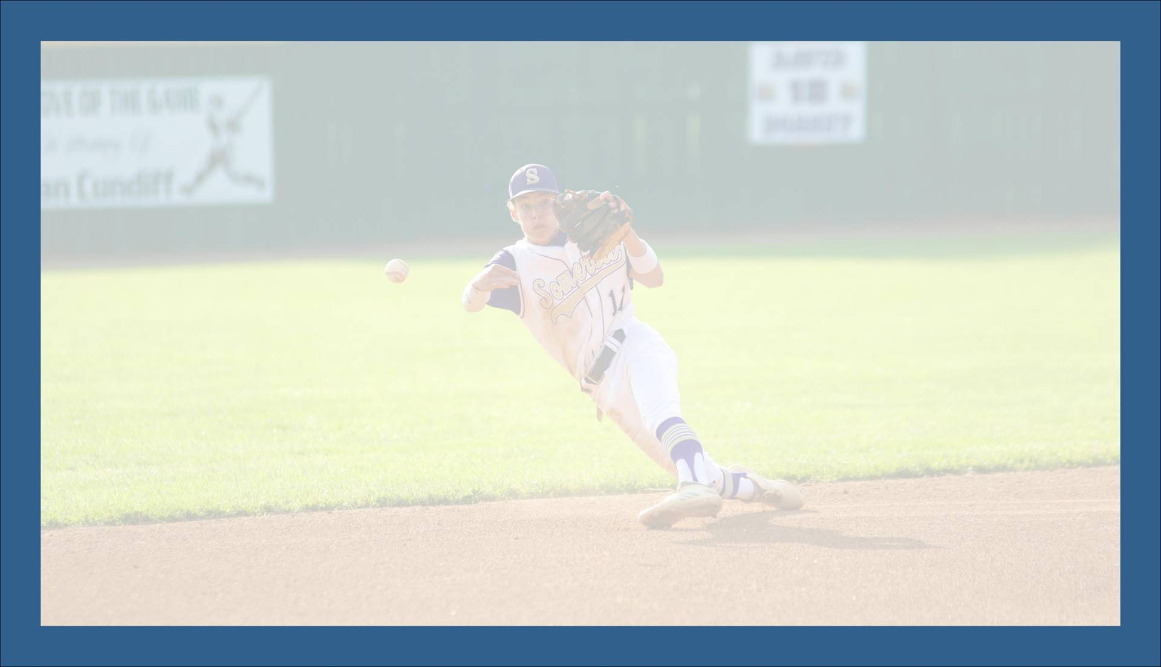
Baseball/Softball Unit - Day 9
What Am I Learning Today? How to Play Various Baseball and Softball Games The Defensive Strategy of Baseball and Softball
Standards Covered S1.E1 - Combines traveling with manipulative skills for the execution of a skill (running and throwing, kicking and running) S1.E2 - Runs for a distance using a mature pattern S1.E14 - Throws overhand to a partner or at a target with accuracy at a reasonable distance. S1.E16 - Catches a batted ball above the head, at chest or waist level, and along the ground using a mature pattern S2.E5 - Strikes a pitched ball with a bat using a mature pattern S3.E2 - Engages actively in all activities of physical education S4.E2 - Participates with responsible personal behavior in a variety of physical activity contexts, environments, and facilities
Daily Warm-Up: Baseline Tag
Review: Playing Defense in Baseball and Softball
Game #1: Fair Ball
Game #2: Tennis Racket Softball

Slide 11
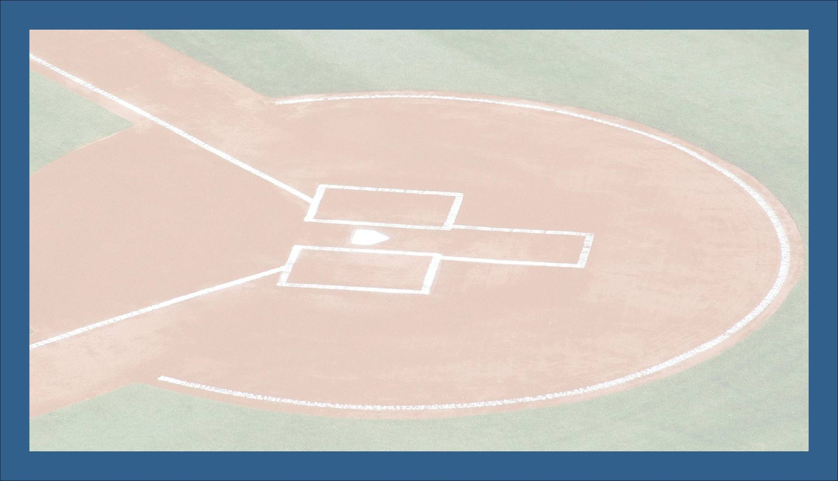
Baseball/Softball Unit - Day 10
Daily Warm-Up: Dynamic Dance Warm-Up
Review: Bunting Strategy
Game #1: Wiffle Ball
Game #2: Baseball/Softball
What Am I Learning Today? The Offensive Strategy of Baseball and Softball The Defensive Strategy of Baseball and Softball
Standards Covered S1.E1 - Combines traveling with manipulative skills for the execution of a skill (running and throwing, kicking and running) S1.E2 - Runs for a distance using a mature pattern S1.E14 - Throws overhand to a partner or at a target with accuracy at a reasonable distance. S1.E16 - Catches a batted ball above the head, at chest or waist level, and along the ground using a mature pattern S2.E5 - Strikes a pitched ball with a bat using a mature pattern S3.E2 - Engages actively in all activities of physical education S4.E2 - Participates with responsible personal behavior in a variety of physical activity contexts, environments, and facilities

Slide 12
Resources
Links and Instructions

Slide 13

Links to All Resources
Day 1
5 Minute Warm-Up for Kids - YouTube - Fitspiration Coach
Always Be a Good Sport - YouTube - WonderGrove Kids
Rules of Baseball - YouTube - Mr.Animate
Wall Target Toss
Day 2
Partner Toss
Tic-Tac-Toe Wall Toss
Basic Throwing Mechanics - YouTube - GoDog Sports
Bucket Toss
Day 3
Base Runner Relay
Softball Throwing Drills and Tips - YouTube - MegRem Softball
How to Fix Short Arm Throwing - YouTube - Bay Island Baseball
Sink the Ship
Day 4
HealthWorks! - YouTube - Cincinnati Children’s
Step Back Catch
Catching the Ball - YouTube - FitKid App
Knock Over Ball
Day 5
Ground Ball Game
Infield Relay
How to Catch a Ball - YouTube - The Hometown All-Stars
Beach Ball Baseball
Day 6
Partner Long Toss
Learning to Catch Fly Balls - YouTube - Little League
Batting Stance - YouTube - FitKids App
Basic Hitting in 4 Steps - YouTube - Pro Speed Baseball
Defense Scores Softball
Day 7
5 Minute Move - YouTube - The Body Coach TV
Foam Ball Batting Cage
How to Hit a Softball - YouTube - MegRem Softball
3 Inning Softball
Soft Toss Baseball
Day 8
High Partner Toss
Home Run Derby
The Basics: Baserunning - YouTube - Little League
Baseless Softball
Day 9
Baseline Tag
Basic Cutoffs and Relays - YouTube - Elite Youth Baseball
Fair Ball
Tennis Racket Softball
Day 10
Dance Money PE Warm-Up - YouTube - Coach Gelardi
Bunting - YouTube - Ripken Baseball
Wiffle Ball
Baseball/Softball
Shape National PE Standards

Slide 14
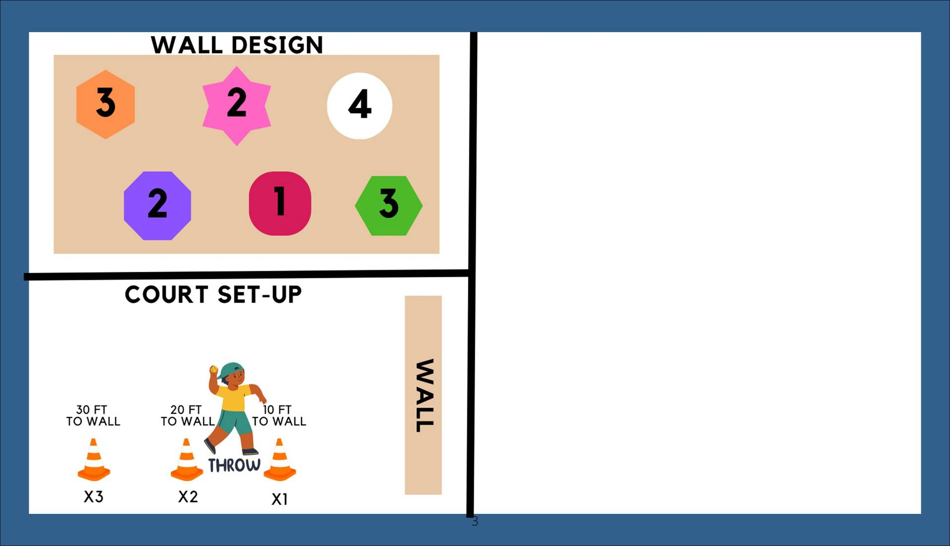
Wall Target Toss
Set-Up: Equipment: (1) ball for each person, targets to tape to wall Set-Up: Use tape to stick targets to the wall (each target should be worth a different point amount. Set cones at varied distances from the wall (10 ft, 20 ft and 30 ft example). Teams: Players will play as individuals during this game
Instructions: Players will throw their ball at the targets and get points for each target hit. There can be as many or as few targets as you would like. The distance players throw from should vary with ability and age Younger students should throw the ball from closer cones while, older or more skilled students could throw from further back cones The goal is to get the maximum amount of points possible on each of their turns throwing the ball
Make it Competitive: This is warm-up and introduction game. As a result, it does not have to be competitive but can just be for practice. Players can compete between each other if you would like. Players can see who can get the most points by using a set number of throws (ex: most points on 10 throws)

Slide 15
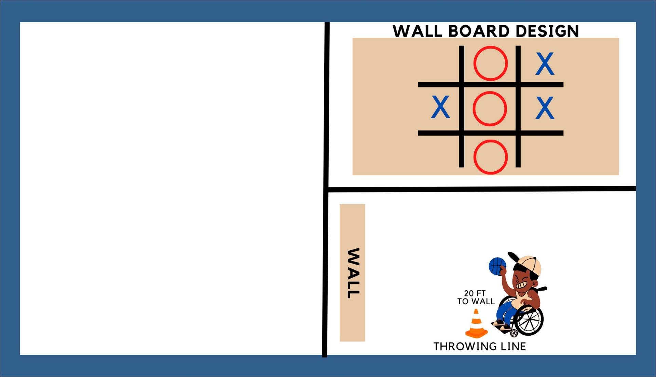
Tic-Tac-Toe Wall Toss
Set-Up: Equipment: (1) ball for each person, (5) “O’s” and (5) “X’s” to stick to wall when a square is hit Set-Up: Tape off a Tic-Tac-Toe board to the wall, use tape to stick “X’s” and “O’s” to the wall Teams: Players will play as individuals during this game
Instructions: Players will throw their ball at the Tic-Tac-Toe board to get that spot. Players alternate throwing the ball at a square. After hitting a square, that player can put their “X” or “O” in that square The winner is the first person to get 3 in a row or the first person to get 5 squares Rule Change: Make it even more fun by allowing people to hit an already occupied square and take it over. Students will love sabotaging each other!
Make it Competitive: Players can compete by setting up a tournament style challenge where winners advance and continue playing until one person is the overall winner.

Slide 16

Partner Toss
Set-Up: Equipment: (1) ball for each group Set-Up: Groups will spread out 10-15 feet from each other (the shape will vary based on numbers in each group) Teams: Players will play as groups in this game. Group size can vary from 2 - 8 (more than 8 in a group is not recommended), 4 is a perfect number.
Instructions: Players will be in groups and will throw and catch the ball between each other Players can throw the ball to any one else in their group, but they cannot throw the ball to the same person twice in a row until they throw to everyone in their group The goal of each group is see how many times they can throw and catch the ball in a row without dropping it. Grouping Options: Allow students of various skill levels to be in each group. More experienced group members can help less experienced members develop their own throwing and catching skills.
Make it Competitive: This game should be used as a fun warm-up activity and skill introduction. It can be competitive by seeing which group can have the most consecutive throws and catches without a drop.

Slide 17
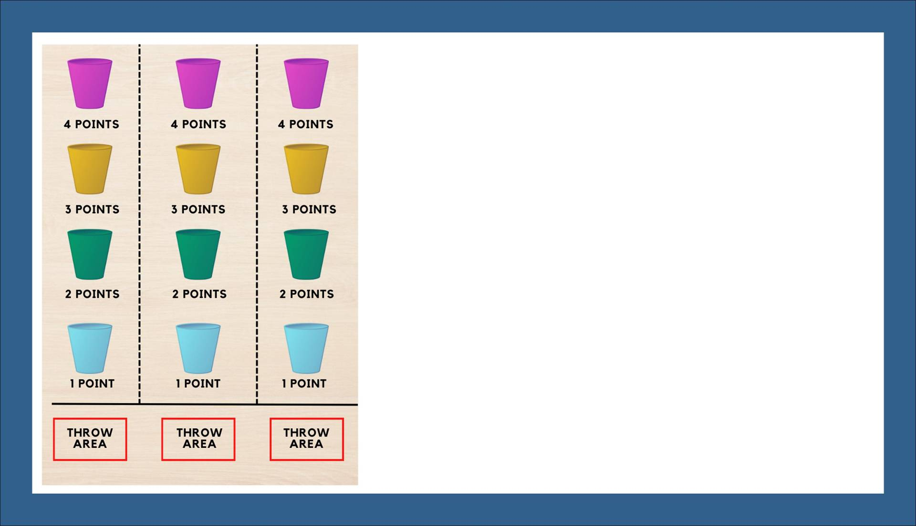
Bucket Ball
Set-Up: Equipment: Multiple balls for each person, buckets or similar objects to use as targets Set-Up: Line buckets up at various distances. Use floor tape or cones to mark off the throwing area and the lanes for each individual or team. Teams: Players can play as individuals or teams during this game.
Instructions: Players will throw their ball at the buckets within their own lane and attempt to make the ball in as many buckets as possible during their turn. Each bucket counts as a different point total (vary distance and point values based on age and skill level) players try to collect as many points by throwing a ball in the bucket from the throwing zone The goal is to get the maximum amount of points possible on each of their turns throwing the ball Have players not are currently throwing, retriever balls for players who miss the bucket
Make it Competitive: Players can compete between each other to see which player can get the most points during a set amount of time (ex: most points in 2 minutes) Players can compete between each other to see which player can get the most points by using a set number of throws (ex: most points on 10 throws)

Slide 18
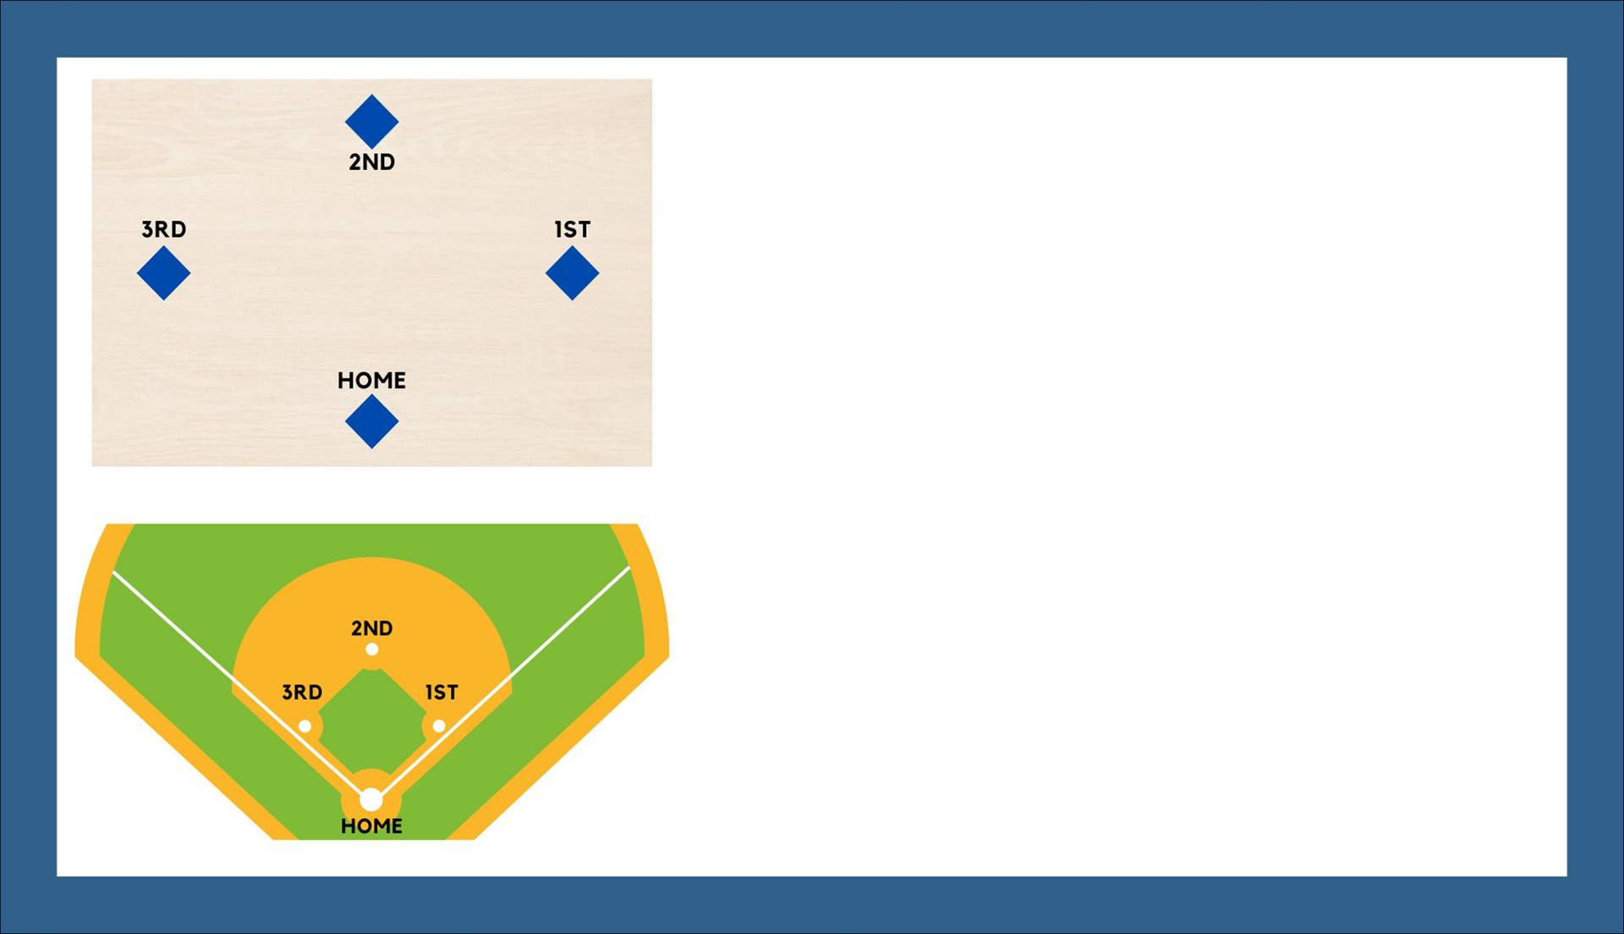
Base Runner Relay
Set-Up: Equipment: Baseball or Softball field with bases or temporary poly spots to use as bases inside or outside Set-Up: If using temporary bases, spread them out 60 feet from each other Teams: Players will play as teams of 5 during this game.
Instructions: Players will start at each base and will run quickly from base to base high fiving their teammate at the next base to tell them to go. The first person to start running will start at home plate (there will be two people at home to start). They will run to first base and high five their teammate who will go to second base and so on The relay ends when each person gets back to the base they started on
Make it Competitive: This game should be used as a fun warm-up activity and skill introduction. Players can compete between each other to see which group can compete the full relay in the shortest amount of time

Slide 19
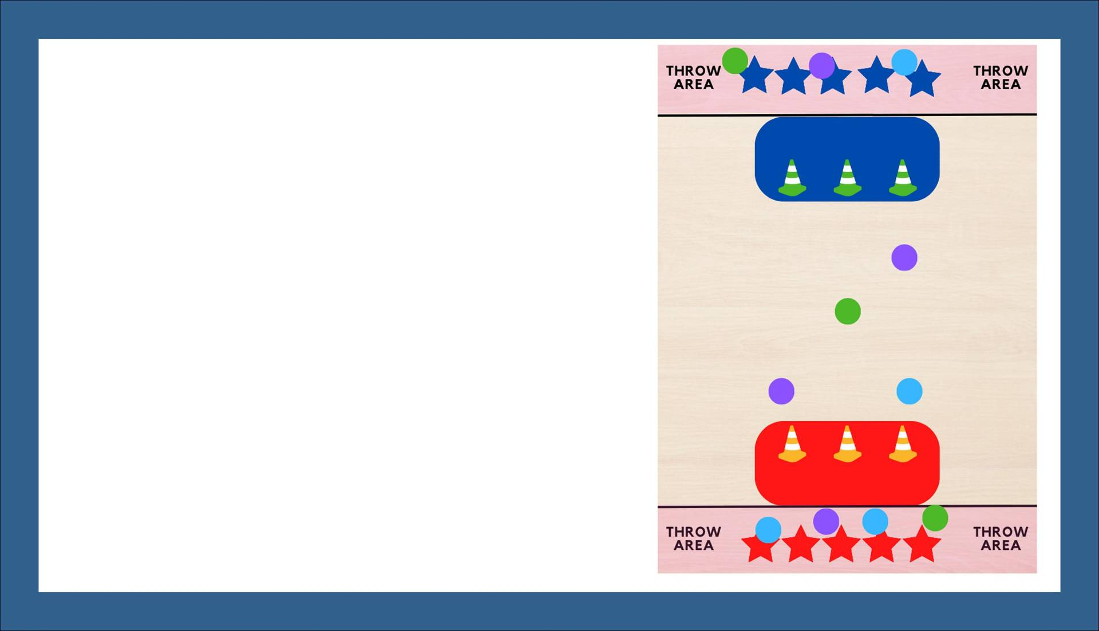
Sink the Ship
Set-Up: Equipment: Multiple foam balls, (6) cones, (2) mats to use as ships, Cones or floor tape to mark off throwing area Set-Up: Place mats on the floor across from each other on each end of the court or field. Place 3 cones on each mat. Teams: Players will play as groups in this game. Group size can vary from 4-8 per team.
Instructions: The goal of this game is to knock over your opponents cones and “Sink Their Ship” Players can throw the ball from anywhere behind the line within the throw area. Players can go outside the throw area to retrieve a ball, but throw from outside the throw area. Players cannot touch a ball in the air or play “defense” to keep a ball from knocking over a cone When a group knocks over all three of their opponents cones they have sunk their opponents ship and won the game
Make it Competitive: The first team to knock over all three of their opponents cones is the winner of the game

Slide 20
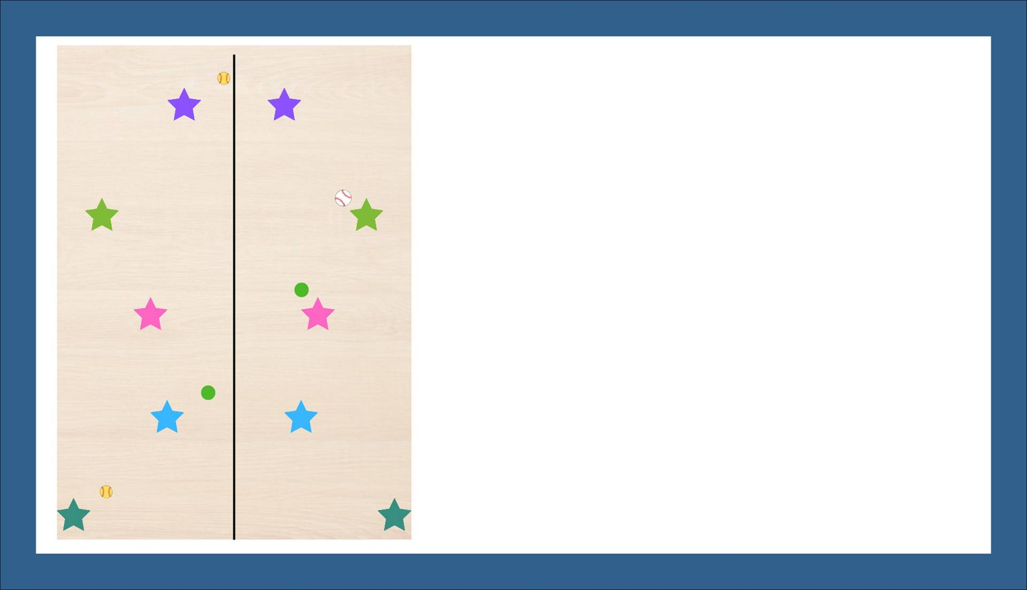
Step Back Catch
Set-Up: Equipment: (1) ball for each partner group (balls can vary between baseballs, softballs or foam balls depending on skill and age), Cones or floor tape to separate middle of floor for starting lines Set-Up: Partners lineup across from each other starting at center line Teams: Each team will be made up of 2 partners
Instructions: Partners are passing the ball between themselves For every successful catch, the partner who caught the ball takes a step back and throws the ball back to their teammate If the ball is dropped, both partners have to return to the middle and start over The goal is to go all the way across the floor passing the ball between partners Optional: If gloves are available more experienced players can start using baseballs and softballs to practice throwing and catching while less experienced players can keep practicing with foam balls
Make it Competitive: Teams can compete between each other to see who can make it the farthest from the center line in a certain amount of time Teams can compete to see which team can be the first team to successful cross the court without dropping the ball

Slide 21
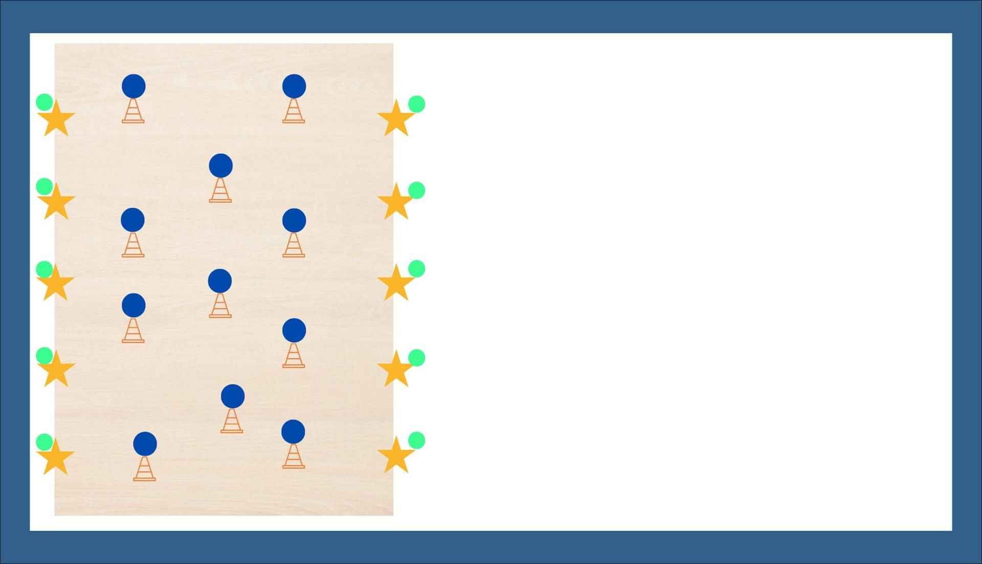
Knock Over Ball
Set-Up: Equipment: Several cones spread out, foam ball for each cone and 10 tennis balls Teams: Teams are made up of 10 players each, 5 start on each side of the court or the field Location: Can be played inside a gym or outside on a field
Instruction: Each team will have 10 players in the field, 5 on each side Each player will start with a tennis ball in their hand Players throw tennis balls at the ball on top of the cones trying to knock them off the cones Players will pick up tennis balls that come across the court or field and throw it back again Players throw continuously until all the balls are knocked off
Make it Competitive: Teams can compete to see who can knock over the most balls in a set amount of time (2 minutes etc)

Slide 22
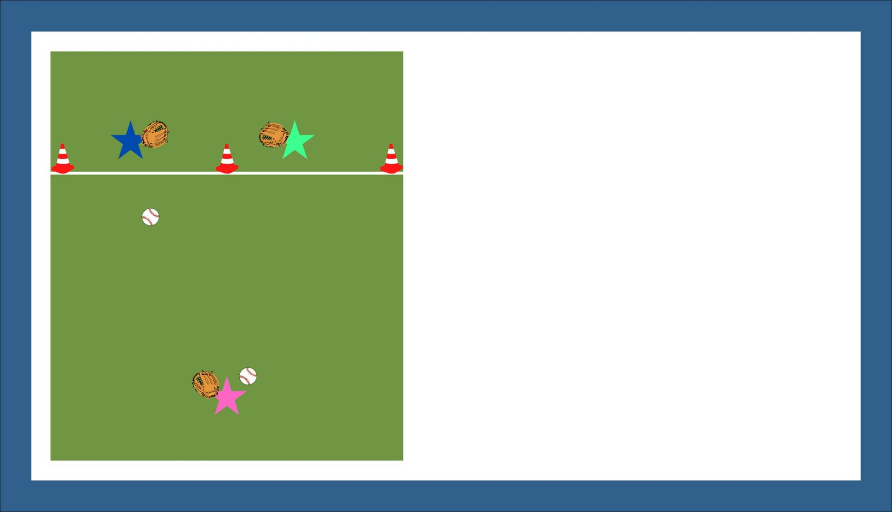
Ground Ball Game
Set-Up: Equipment: 2 Baseballs, Softballs or Tennis Balls per Group (One glove for each group member if using baseballs or softballs), (3) Cones to separate zones Set-Up: Use cones to create two separate fielding zones. This game can be played indoors or outdoors. Teams: Groups are made up of 3 people per group
Instruction: Each group will be working on fielding ground balls and throwing them back to their partner One partner starts away from the line while the other two people will be in their area separated by cones and behind the line. The first group member will throw ground balls to the partners between the cones. Players must stay inside their cones in order to field a ball. After fielding a ball they throw it back to their group member and wait on the next ball.
Make it Competitive:: This game should be used as a fun warm-up activity and skill introduction. You can make it competitive by giving each group member a point for every ball they field and throw back correctly.

Slide 23

Infield Relay
Set-Up: Equipment: 1 Baseball, Softball or Tennis Ball per Group (One glove for each group member if using baseballs or softballs), (4) Cones or poly spots to separate bases (optional) Set-Up: If not using a field, setup bases 60 feet apart for the relay. Teams: Groups are made up of 4 people per group
Instruction: Each group will be working on throwing and catching the ball One member of the group will start with the ball and throw it to the next base (Home → 1st → 2nd → 3rd → Home) The goal of the activity is to throw it all around the bases without dropping the ball or having a bad throw. Players with increased skill levels should also work on doing it quickly as well.
Make it Competitive:: This game should be used as a fun warm-up activity and skill introduction. You can make it competitive by seeing which group can make the relay throws around the bases the most times without dropping it or which team can complete a single relay the quickest.

Slide 24

Beach Ball Baseball
Set-Up: Equipment: (1) Beach Ball, (1) Tennis Racket or large wiffle ball bat, Cones to create outfield fence boundary line Set-Up: Use existing baseball or softball field (if not available use cones or poly spots to create bases), align cones on the edge of the infield to create a fence Teams: Teams are made up of 5-7 people
Instruction: Teams will be playing regulation baseball or softball using a beach ball Teachers or more skilled students can act as a pitcher while other students play in the field Batters can use either a tennis racket or a large wiffle ball bat to hit the ball The cones on the infield edge act as the boundary fence. Any ball that goes past the boundary is a dead ball and all runners must freeze where they are The game can be played for 3 innings
Make it Competitive:: The game can be played two ways. 1) Regulation rules with 3 outs per inning 2) Every player gets to bat each inning This game should be fun for everyone and competition should be introduced slowly to allow everyone to understand the game

Slide 25

Partner Long Toss
Set-Up: Equipment: 1 Baseball, Softball or Tennis Ball per Group (One glove for each group member if using baseballs or softballs) Set-Up: Partner will need to spread out across from each other as far as their age and skill level will allow Teams: Players will play with a partner during this game
Instruction: Each group will be working on throwing and catching the ball from a longer distance away Partners lineup across from each other and will be working on throwing and catching long throws Players work on catching balls in the air and learning to throw the correct distance to their partner This warm-up activity can be used to build up to any activity and is an excellent way for players to develop their individual skills
Make it Competitive:: This game should be used as a fun warm-up activity and skill introduction.

Slide 26
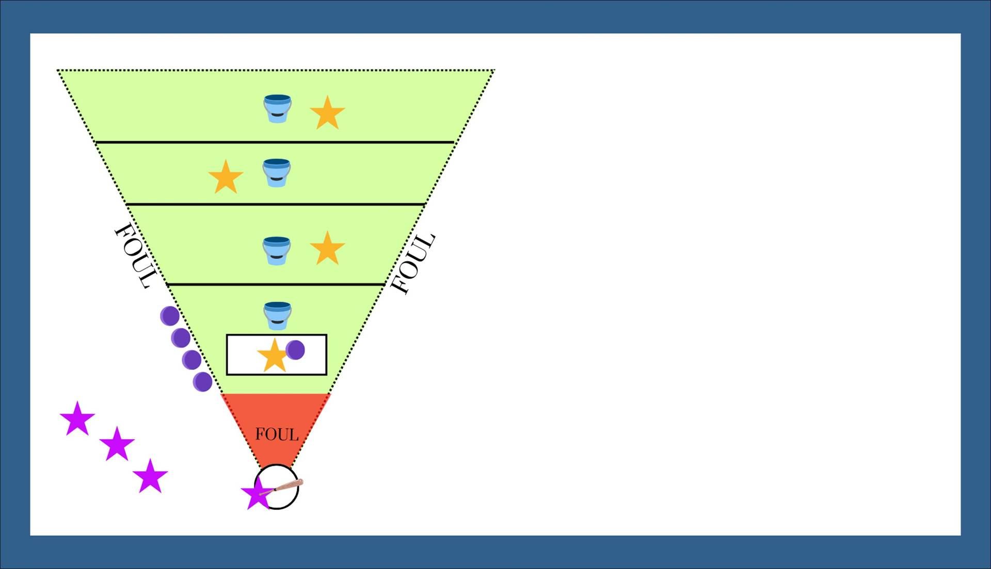
Defense Scores Softball
Set-Up: Equipment: (10) Foam Balls and (1) Large Plastic Bat or Tennis Racket, (4) Buckets, and Cones or Floor Tape to Separate Areas Set-Up: Use cones or floor tape to create 4 separate fielding areas and the foul territories Teams: Teams will be made up of 4 players each
Instruction: Each team will have all 4 players in the field at one time, one player will pitch (or have a teacher pitch for younger players) and the others will spread out in the marked off areas with a bucket The batting team will alternate batters in the same order each time The pitcher will pitch ten balls to the batting team. All balls must be hit to count, two foul balls and the batters have to switch and place a ball in a bucket Any ball caught in the air or on a single bounce in fair territory goes into a bucket, any ball that isn’t caught in air or single bounce goes outside the field lines in the foul area Teams rotate batting teams after all 10 balls are either outside the lines or in a bucket
Make it Competitive:: Each Ball in Bucket = 1 Point for Fielding Team Each team gets 3 turns at bat The team with the most points at the end wins

Slide 27

Foam Ball Batting Cage
Set-Up: Equipment: Multiple foam balls, (1) large wiffle ball bat or tennis racket, polyspot or base to use for home plate and pitcher’s mound Set-Up: One player will be batting, one player will be the pitcher and everyone else will be in the field catching and retrieving balls Teams: Players will play as individuals in this game
Instruction: This skill review game will allow players to work on batting, pitching and defensive skills all while all players are engaged in the activity The pitcher will rotate to the batter, the batter will go into the field and a fielder will become the new pitcher Each batter gets the chance to hit 10 balls before rotating to new positions This game is an excellent review and way to engage all students at one time
Make it Competitive:: This game should be used as a fun skill review activity To make it competitive you can develop a scoring system for this game 1) Give batters points for every ball hit into certain areas 2) Give fielders points for every ball caught in the air

Slide 28

Soft Toss Baseball
Set-Up: Equipment: (1) Baseball or Softball, (1) Bat, Gloves for Player Playing in Field Set-Up: Use existing baseball or softball field (if not available use cones or poly spots to create bases), align cones on the edge of the infield to create a fence Teams: Teams are made up of 9-10 people
Instruction: Teams will be playing regulation baseball or softball game while a teacher or coach softly tosses the ball from the side to the batter Players will alternate batting and fielding in two ways, either 3 outs and switch or everyone on each team bats and then switch The game can be played for 3 innings
Make it Competitive:: The game can be played two ways. 1) Regulation rules with 3 outs per inning 2) Every player gets to bat each inning This game should be fun for everyone and competition should be introduced slowly to allow everyone to understand the game Less skilled or younger players may still play this game, while using a tee to hit

Slide 29

3 Inning Softball
Set-Up: Equipment: (1) Baseball, Softball or Tennis Ball (if using baseball or softball you will need full safety equipment including helmets and gloves), (1) Baseball or Softball Bat Set-Up: Use existing baseball or softball field (if not available use cones or poly spots to create bases) Teams: Players are split into teams of 9-10
Instruction: Defensive teams will have 9-10 players in the field including a pitcher and catcher Batting teams will bat in order Teams will play a regulation game for 3 total innings Additional “house” rules can be applied to fit your teams best
Scoring: The team with the most runs after completion of the 3 innings will be the winner

Slide 30

High Partner Toss
Set-Up: Equipment: 1 Baseball or Tennis Ball per set of Partners (One Glove for Each Set of Partners if using baseball), Cones to separate zones Set-Up: Create 5 sections with cones or floor tape if doing inside, one partner starts as the thrower and the other starts as the fielder in the outfield Teams: Teams are made up of sets of partners
Instruction: Each set of partners will work together to catch a fly ball in each zone One partner starts in a zone and must catch a fly ball thrown from their partner before moving to the next zone After catching a ball in each zone, partners switch places and the other partner will need to catch one ball in each zone
Scoring: This game should be used as a fun skill review activity To Make it Competitive Use Timed Scoring Partners will be timed for how long it takes each group to catch a fly ball in each zone The partner group that completes all the zones the quickest are the winner

Slide 31
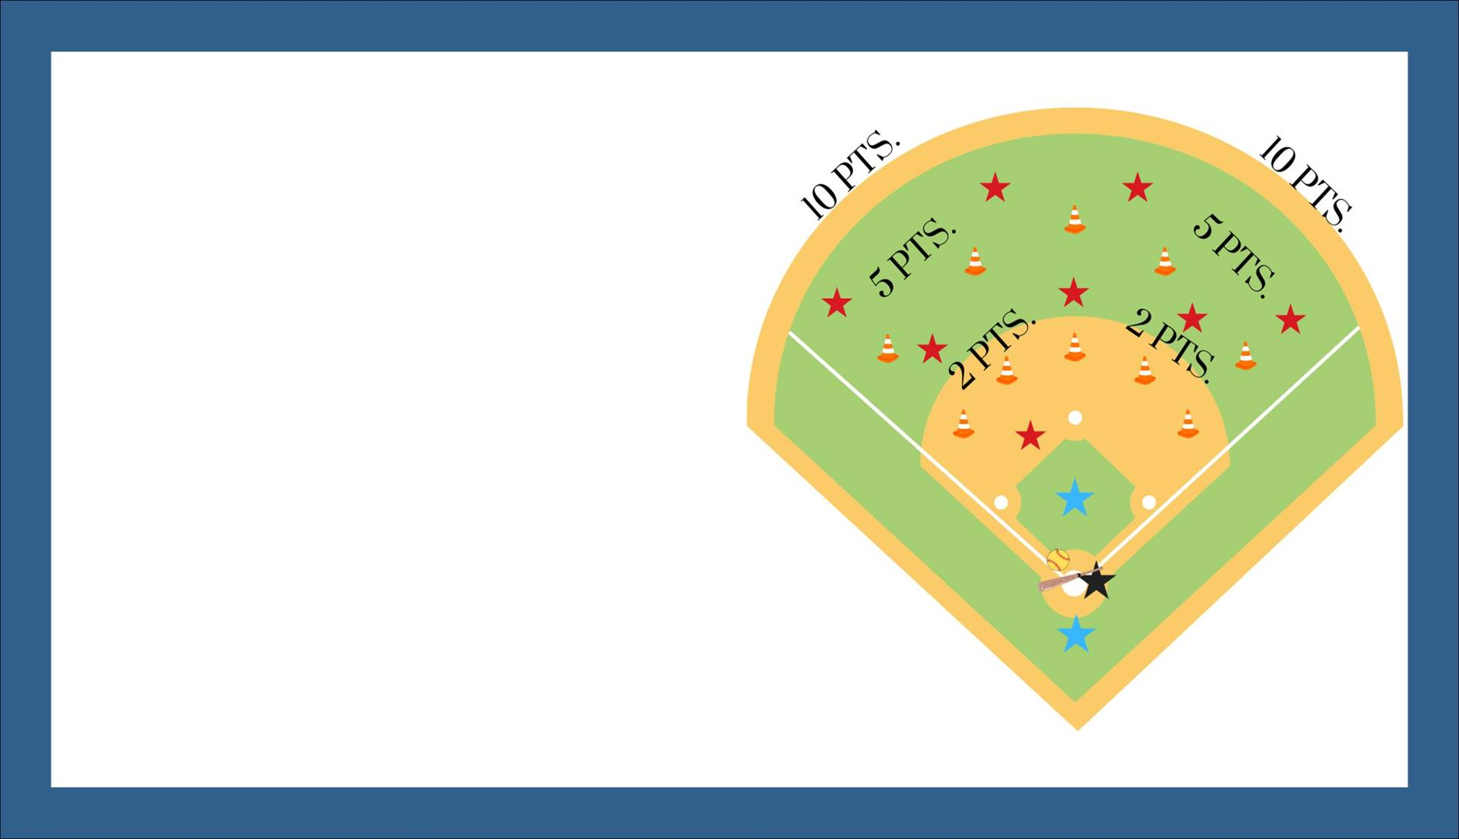
Home Run Derby
Set-Up: Equipment: Multiple Baseballs, Softballs, or Tennis Balls, (1) Baseball, Softball bat or tennis racket, Cones to mark off field Set-Up: Use cones to mark “home run scoring zones” (adjust length away from home plate based on age and ability levels) Teams: Players will play as individuals during this game
Instruction: Either a coach or player can be full time pitcher Each player will get 10 total pitches to hit. Any ball that is hit by the bat counts as a hit. The player tries to hit as many balls as possible into the homerun areas. Each ball that lands in each homerun area counts towards the players total points Any additional players can help catch and retrieve balls in the field
Scoring: The person that gets the most points from home runs wins the game Any ties, are decided with a 5 pitch overtime

Slide 32
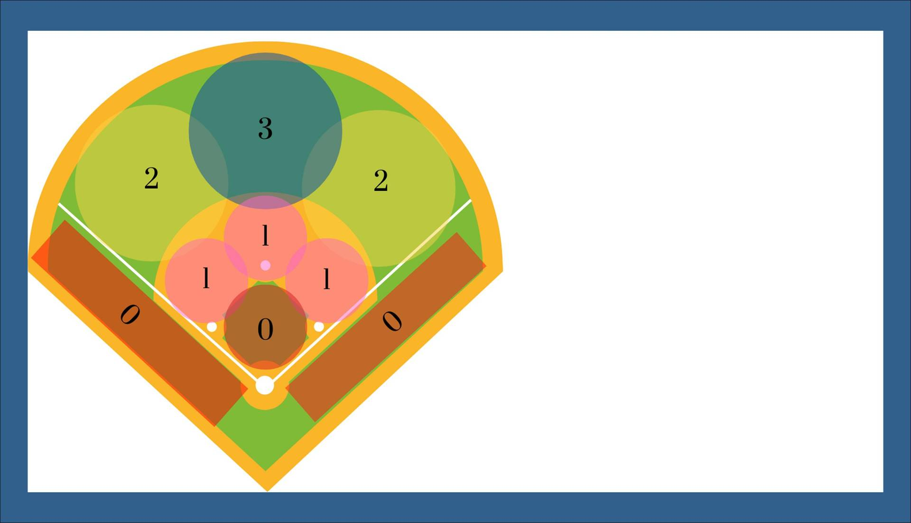
Baseless Softball
Set-Up: Equipment: (1) Baseball, Softball or Tennis Ball, (1) Bat or Tennis Racket, Cones to mark off field, Gloves for players in the field (if using a baseball or softball) Set-Up: Use cones or floor tape to mark off individual scoring zones. Teams: Players will play as teams of 9-10 during this game.
Instruction: Either a coach or player can be full time pitcher Each inning will be played as regular softball. The players will not run though, instead they get the number of points based off where the ball first lands. Each team tries to hit as many balls as possible into the various scoring areas Players get the number of points for wherever their balls land within the scoring area If the defensive team catches the ball in the air, it is an out. A ground ball must land outside the first “0” scoring area to count for points. Any ball that lands in a scoring area counts towards the batting team. Teams switch sides after 3 outs.
Scoring: The team with the most points after a set number of innings will be the winner

Slide 33

Baseline Tag
Set-Up: Equipment: (1) Baseball, Softball or Foam Ball Per Group, (2) Gloves Per Group (if using a baseball or softball), (2) Ploy Spots or Bases Per Group (to use at the end of each base line). Set-Up: Set bases apart 60 feet on a straight line, Teams: Players will play as both an individual and as a partner team during this game
Instruction: This skill review game will allow players to work on running the bases and also throwing, catching and tagging base runners. Players will rotate through being a runner and a tagger multiple times throughout the game Each runner starts in the middle of the baseline with the other two players will start on the bases. The taggers will throw the ball back and forth to attempt to tag the runner before they get to a base, the runner can only be tagged by the player with the ball. The runner can be safe at either base if they make it before being tagged.
Make it Competitive:: This game should be used as a fun skill review activity To make it competitive you can develop a scoring system for this game 1) Give runners points for each time they are successful getting back to the base 2) Give both taggers points for each time they successfully tag a runner out 3) The person with the most total points at the end is the winner

Slide 34
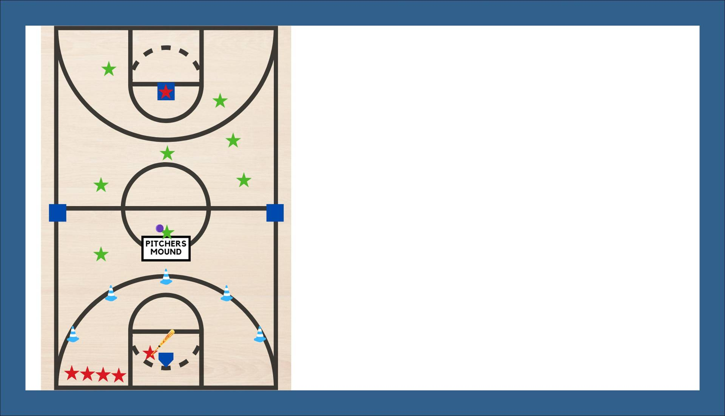
Fair Ball
Set-Up: Equipment: (1) Foam Ball, (1) Tennis Racket or large wiffle ball bat, Cones to mark fair ball territory, (4) Poly Spots to use as bases Set-Up: This indoor game is setup using the existing lines of a basketball court. Cones are spread out over the three point line to mark fair balls, bases are spread out around the gym floor Teams: Teams are made up of 5-10 players per team
Instruction: Teams can be made up of varying amounts of members but they need to be even teams and try to limit teams to 10 players for the most fun game. The team in the field will have one player inside the pitching mound to pitch to each batter, the other players spread out around the gym as fielders Each batter will hit the pitch and try to hit it outside of the 3 point line, any ball that goes through the 3 point line is a fair ball. Batters can hit balls sideways or forward, as long as it goes through the 3 point line the ball is fair. Any ball that does not go through the 3 point line is a strike, players get 3 strikes before they are out. Any pitch not hit does not count, players must hit the ball for it to count. Once the fielding team gets three outs, the teams switch.
Make it Competitive:: This game is played with regulation rules with 3 outs per inning This game should be fun for everyone and competition should be introduced slowly to allow everyone to understand the game

Slide 35

Tennis Racket Softball
Set-Up: Equipment: (1) Tennis Ball, (1) Tennis Racket, Gloves for Each Defensive Player (optional) Set-Up: Use existing baseball or softball field (if not available use cones or poly spots to create bases) Teams: Teams are made up of 9-10 players each, all players play in the field at the same time
Instruction: Each team will have 9-10 players in the field Players can align however they want defensively - you must have a catcher A coach or designated player will pitch for both teams Batters cannot “bunt” the ball Three foul balls and the batter is out Each player must bat in the same order throughout the game This game can be played with gloves or without since you are playing with a tennis ball
Scoring: Teams each get 3 outs to score as many runs as possible in each inning Each team will get 3 at bats for a total of 3 innings (if the team leading has the last at bat, they do not bat again) Rotate teams as needed to get as many games as possible played

Slide 36
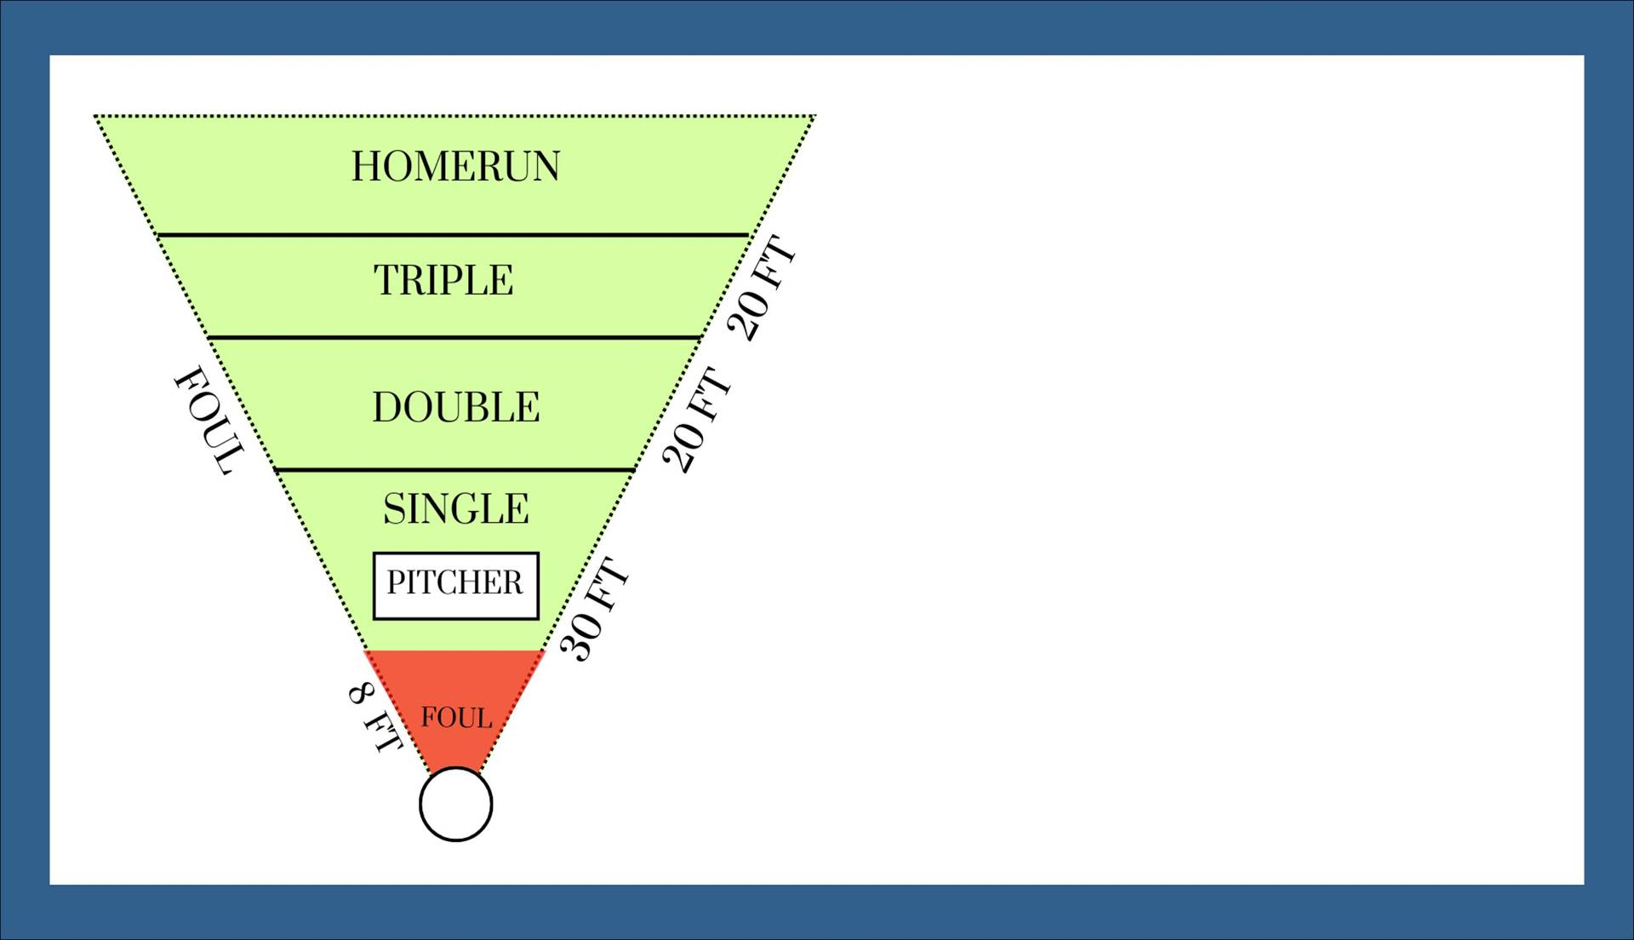
Wiffle Ball
Set-Up: Equipment: 1 Wiffle Ball and 1 Wiffle Ball Bat, Cones or similar to designate areas on field, strike zone target (Here is a Link to Build Your Own) Set-Up: Field will be set-up using the diagram shown to the left Players: Minimum of 2 (pitcher and fielder) - Maximum of 5 (pitcher, catchers, 1 field in each area)
Instruction: See the Official Rules of Wiffle Ball Here!
Scoring: Teams will play for a designated number of innings, the team with the most runs at the end of the game is the winner

Slide 37
Baseball/Softball
Set-Up: Equipment: (1) Baseball, Softball or Tennis Ball (if using baseball or softball you will need full safety equipment including helmets and gloves), (1) Baseball or Softball Bat Set-Up: Use existing baseball or softball field (if not available use cones or poly spots to create bases) Teams: Players are split into teams of 9
Instruction: Defensive teams will have 9 players in the field including a pitcher and catcher Batting teams will bat in order Teams will play a regulation game for a designated number complete innings Additional “house” rules can be applied to fit your teams best
Scoring: The team with the most runs after completion of the designated number of innings

