Slide 1
Google Forms
Student Self-Assessment Links and Instructions

Slide 2
Table of Contents
Link to Create Your Own Copies of the Student Self-Assessment Form
Creating Your Own Copies of Forms
Getting Your Results (Option 1) - Downloading Current Results
Getting Your Results (Option 2) - Creating an Updating Spreadsheet
Contact Us

Slide 3
Student Self-Assessment Link
Flag Football Unit Self-Assessment Google Form Link

Slide 4
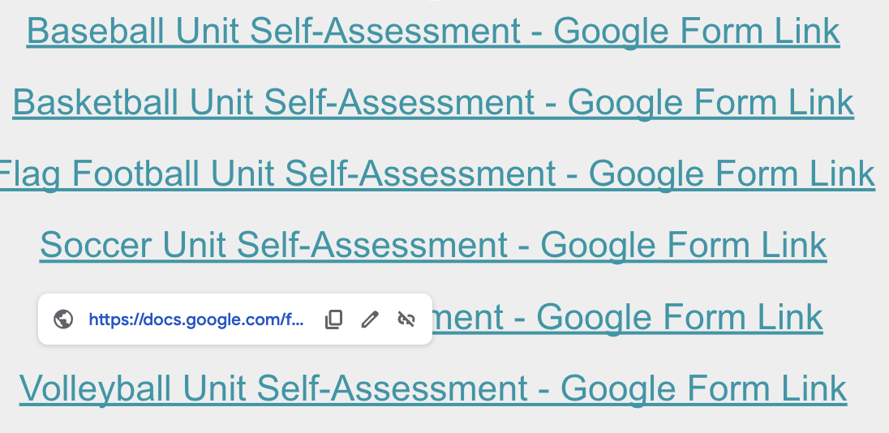
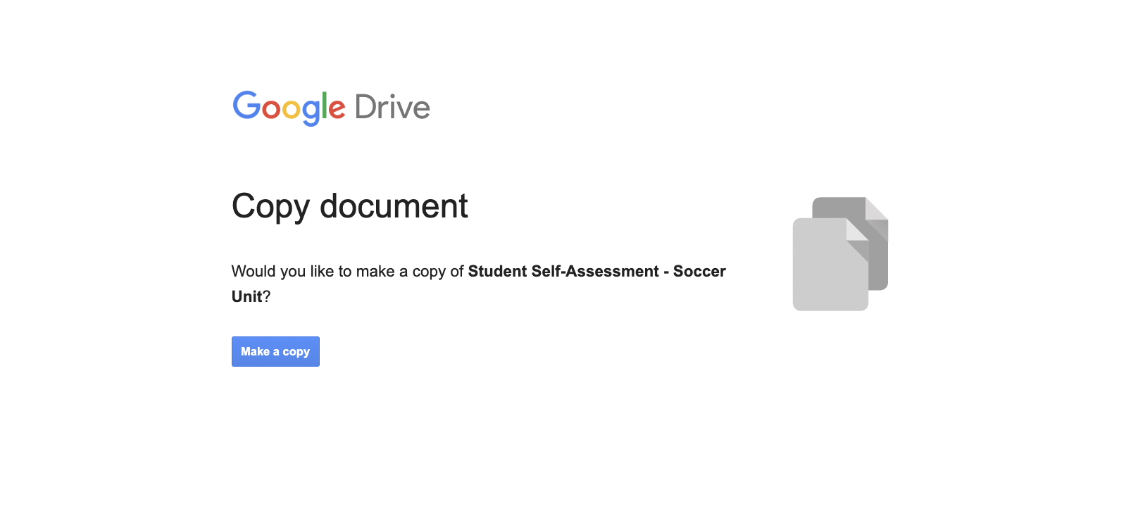
Creating Your Own Copies of Forms
Click on an Self-Assessment Link
Click on the pop-up link to open the Google Form
Select “Make a Copy”

Slide 5
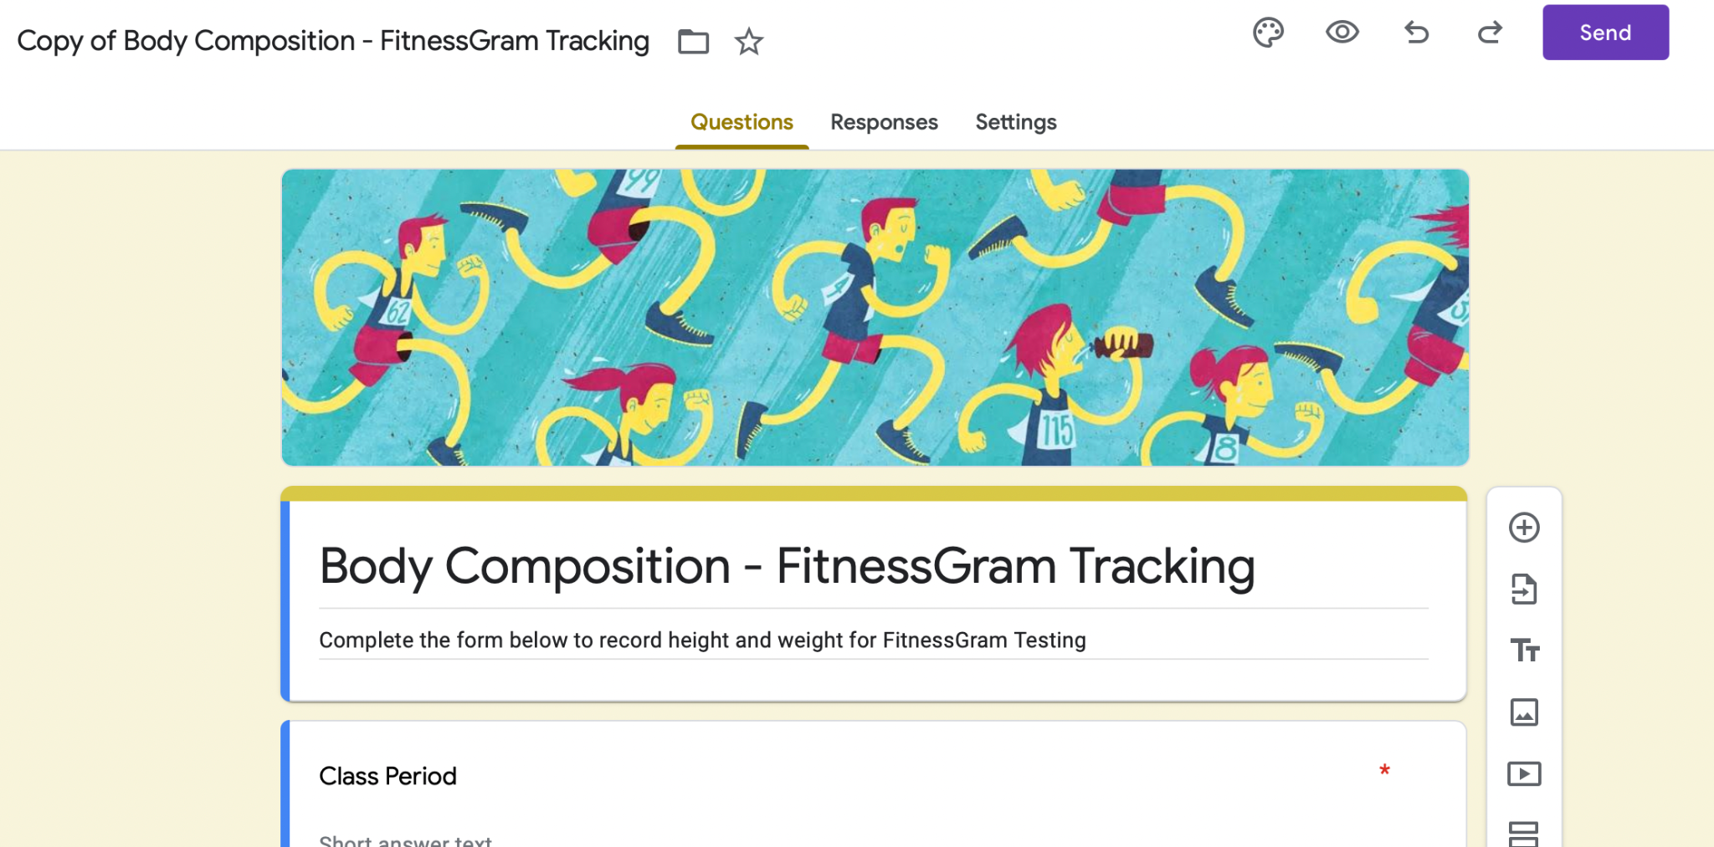
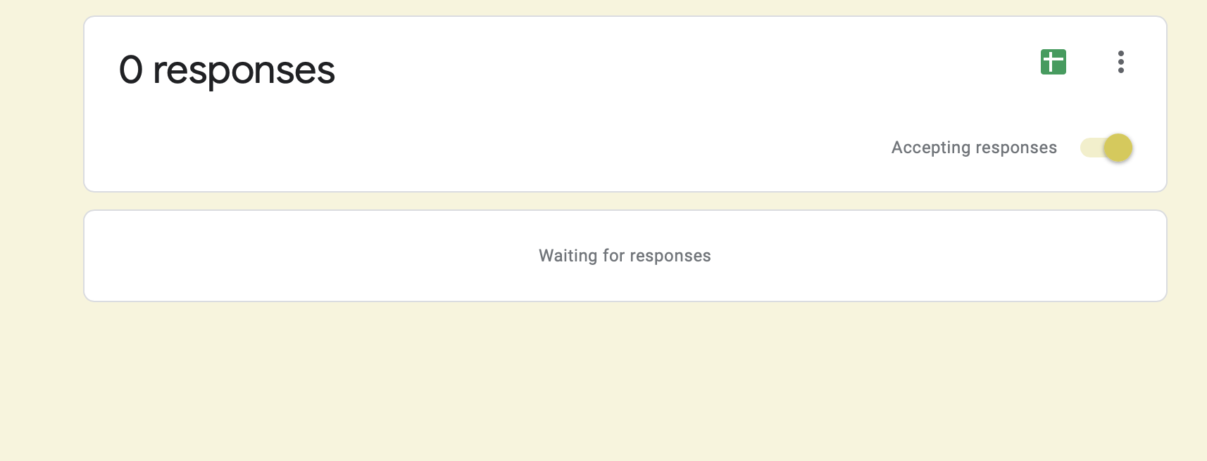
Getting Your Results (Option 1) - Downloading Current Results
After opening your copy of the Google Form, click on Responses
Click on Three Dot Icon
Make Sure the “Accepting Responses” Slider is Clicked
Select Download Responses (.csv)

Slide 6
Getting Your Results (Option 2) - Creating an Updating Spreadsheet
After opening your copy of the Google Form, click on Responses
Click on Three Dot Icon
Make Sure the “Accepting Responses” Slider is Clicked
Choose “Select Response Destination”

Slide 7
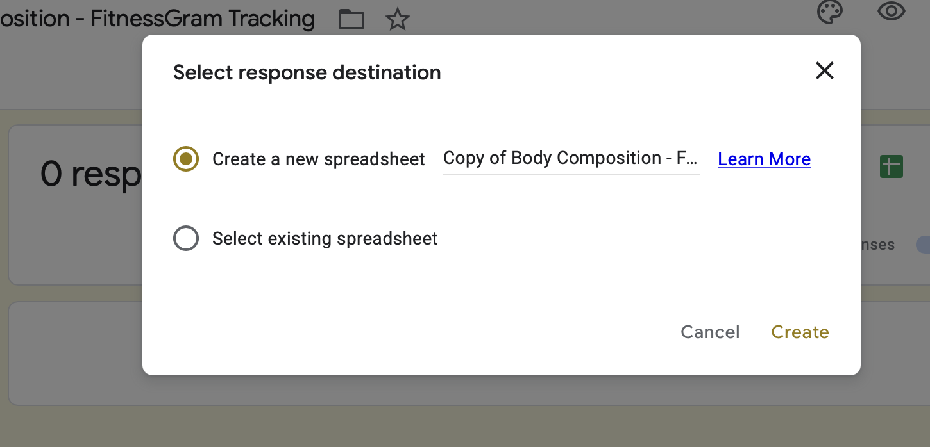
Getting Your Results (Option 2) - Creating an Updating Spreadsheet (Cont’d)
You can now choose to create a new spreadsheet for your results or add your results to an existing spreadsheet
These results will update automatically each time a student submits a new response

Slide 8
Contact Us
Questions or Concerns?
Click Here for Help!

